Slide 1
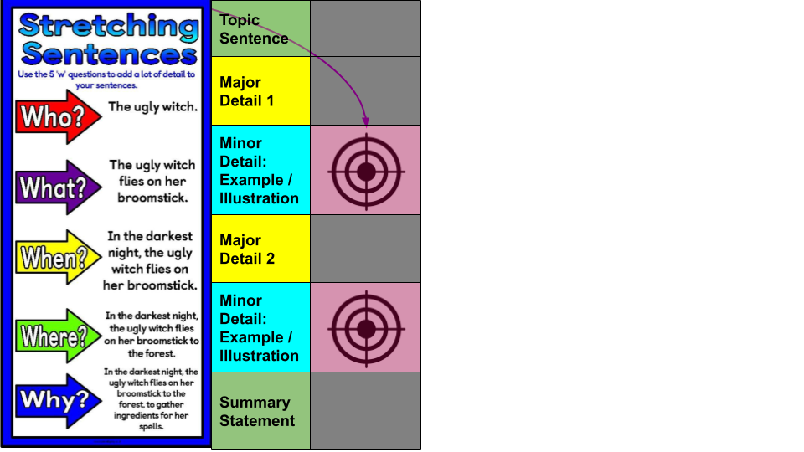
Word
Bank
__________ is someone I admire for several reasons.
One reason I admire __________ is because . . .
Another reason I admire __________ is because . . .
These are a few reasons I admire __________.
For example,
For instance,
Specifically,
To illustrate,
such as
including
Drag and drop one transition to each minor detail.
Notes:
(for) example including (as an) illustration one
(for) instance specifically to illustrate once
such as to be specific

Slide 2
Graphic Organizer
Major Detail 1: One reason I admire __________ is because . . .
Who | What | When | Where | Why
Major Detail 2: Another reason I admire I admire __________ is because . . .
Who | What | When | Where | Why

Slide 3
